Slide 1
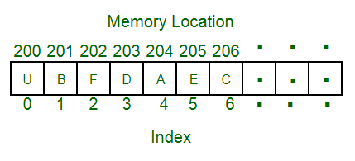
Arrays:
What Are Arrays in Data Structures?
An array is a linear data structure that collects elements of the same data type and stores them in contiguous and adjacent memory locations.
Arrays work on an index system starting from 0 to (n-1), where n is the size of the array.

Slide 2
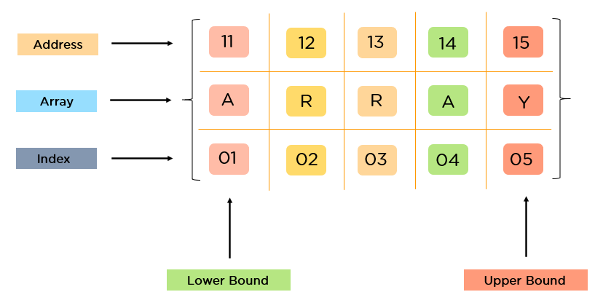

Slide 3
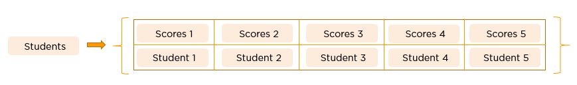
Why Do You Need an Array in Data Structures?
Consider a class consists of 50 students, and the class advisor has to publish their results.
If he/she had to declare all 50 variables individually, it would be challenging to manipulate and maintain the data.
If more students were to join, it would become more difficult to declare all the variables and keep track of it.
To overcome this problem, arrays came into the picture.

Slide 4

What Are the Types of Arrays?
There are majorly two types of arrays, they are:
One-Dimensional Arrays: int array-name[size];

Slide 5
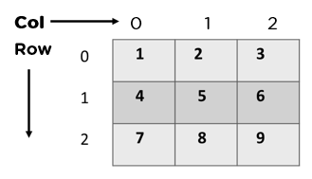
Multi-Dimensional Arrays:
These multi-dimensional arrays are again of two types. They are:
Two-Dimensional Arrays.

Slide 6
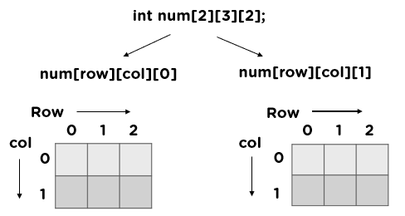
Three-Dimensional Arrays.

Slide 7
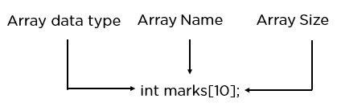
How Do You Declare an Array?
Arrays are typically declared with square brackets with the size of the arrays as its argument.
Here is the syntax for arrays declaration:
1D Arrays: int arr[n];
2D Arrays: int arr[m][n];
3D Arrays: int arr[m][n][o];

Slide 8
How Do You Initialize an Array?
Arrays can be initialized in four different ways:
Method 1:
int a[6] = {2, 3, 5, 7, 11, 13};
Method 2:
int arr[]= {2, 3, 5, 7, 11};
Method 3:
int n;
scanf(“%d”,&n);
int arr[n];
for(int i=0;i<5;i++)
{
scanf(“%d”,&arr[i]);
}

Slide 9
Method 4:
int arr[5];
arr[0]=1;
arr[1]=2;
arr[2]=3;
arr[3]=4;
arr[4]=5;

Slide 10

How Can You Access Elements of Arrays in Data Structures?
You can access elements with the help of the index at which you stored them.

Slide 11
Example program:
#include<stdio.h>
int main()
{
int a[5] = {2, 3, 5, 7, 11};
printf(“%d\n”,a[0]); // we are accessing
printf(“%d\n”,a[1]);
printf(“%d\n”,a[2]);
printf(“%d\n”,a[3]);
printf(“%d”,a[4]);
return 0;
}

Slide 12
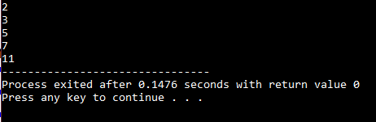
Output:

Slide 13
What Operations Can You Perform on an Array?
Traversal
Insertion
Deletion
Searching
Sorting

Slide 14
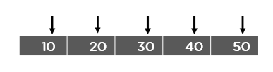
Traversing the Array:
Traversal in an array is a process of visiting each element once.

Slide 15
Example program for array traversal:
#include<stdio.h>
int main()
{
int a[5] = {2, 3, 5, 7, 11};
for(int i=0;i<5;i++)
{
//traversing ith element in the array
printf(“%d\n”,a[i]);
}
return 0;
}

Slide 16
Output:

Slide 17
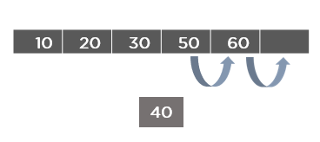
Insertion in an Array:
Insertion in an array is the process of including/adding one or more elements in an array.
Insertion of an element can be done:
At the beginning
At the end and
At any given index of an array.

Slide 18
At the Beginning:
#include<stdio.h>
int main()
{
int array[10], n,i, item;
printf("Enter the size of array: ");
scanf("%d", &n);
printf("\nEnter Elements in array: ");
for(i=0;i<n;i++)
{
scanf("%d", &array[i]);
}

Slide 19
printf("\n enter the element at the beginning");
scanf("%d", &item);
n++;
for(i=n; i>1; i--)
{
array[i-1]=array[i-2];
}
array[0]=item;
printf("resultant array element");
for(i=0;i<n;i++)
{
printf("\n%d", array[i]);
}
getch();
return 0;
}

Slide 20
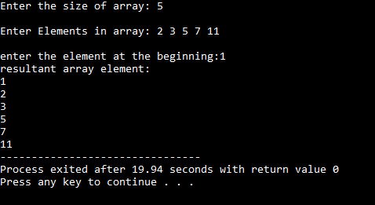
Output:

Slide 21
At the End:
#include<stdio.h>
#include<conio.h>
int main()
{
int array[10], i, values;
printf("Enter 5 Array Elements: ");
for(i=0; i<5; i++)
scanf("%d", &array[i]);
printf("\nEnter Element to Insert: ");
scanf("%d", &values);
array[i] = values;
printf("\nThe New Array is:\n");
for(i=0; i<6; i++)
printf("%d ", array[i]);
getch();
return 0;
}

Slide 22
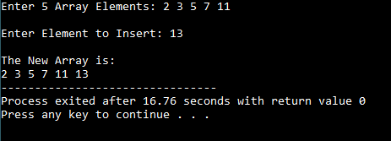
Output:

Slide 23
At a Specific Position:
#include <stdio.h>
int main()
{
int array[100], pos, size, val;
printf("Enter size of the array:");
scanf("%d", &size);
printf("\nEnter %d elements\n", size);
for (int i = 0; i < size; i++)
scanf("%d", &array[i]);
printf("Enter the insertion location\n");

Slide 24
scanf("%d", &pos);
printf("Enter the value to insert\n");
scanf("%d", &val);
for (int i = size - 1; i >= pos - 1; i--)
array[i+1] = array[i];
array[pos-1] = val;
printf("Resultant array is\n");
for (int i = 0; i <= size; i++)
printf("%d\n", array[i]);
return 0;
}

Slide 25
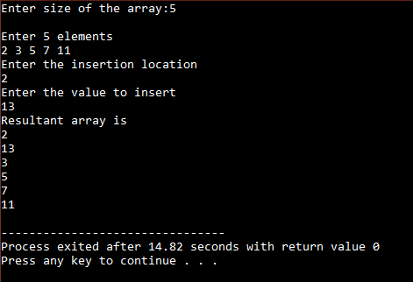
Output:

Slide 26
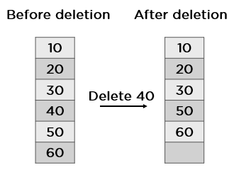
Deletion in an Array:
Deletion of an element is the process of removing the desired element and re-organizing it.
Deletion can be done in different ways:
At the beginning
At the end
At a specified location.

Slide 27
At the Beginning:
#include<stdio.h>
int main()
{
int n,array[10];
printf("enter the size of an array");
scanf("%d" ,&n);
printf("enter elements in an array");
for(int i=0;i<n;i++)
scanf("%d", &array[i]);

Slide 28
n--;
for(int i=0;i<n;i++)
array[i]=array[i+1];
printf("\nafter deletion ");
for(int i=0;i<n;i++)
printf("\n%d" , array[i]);
}

Slide 29
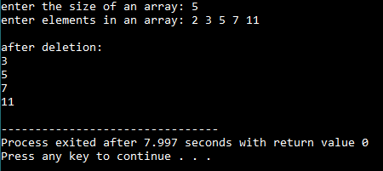
Output:

Slide 30
At the End:
#include<stdio.h>
int main()
{
int n,array[10];
printf("enter the size of an array");
scanf("%d" ,&n);
printf("enter elements in an array");
for(int i=0;i<n;i++)
scanf("%d", &array[i]);
printf("\nafter deletion array elements are");
for(int i=0;i<n-1;i++)
printf("\n%d" , array[i]);
}

Slide 31
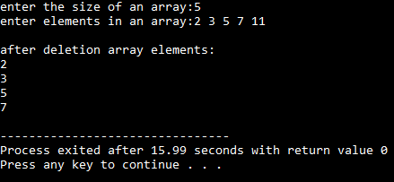
Output:

Slide 32
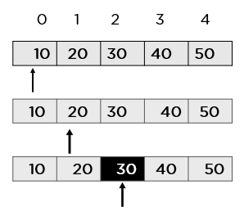
Searching for an Element:
The method of searching/finding for a specific value in an array is known as searching.
There are two ways we can search in an array, they are:
Linear search
Binary search

Slide 33
Linear Search:
A linear search is the simplest approach employed to search for an element in a data set.
It examines each element until it finds a match, starting at the beginning of the data set, until the end.
The search is finished and terminated once the target element is located. If it finds no match, the algorithm must terminate its execution and return an appropriate result.
The linear search algorithm is easy to implement and efficient in two scenarios:
When the array contains lesser elements.
When searching for a single element in an unordered array.

Slide 34
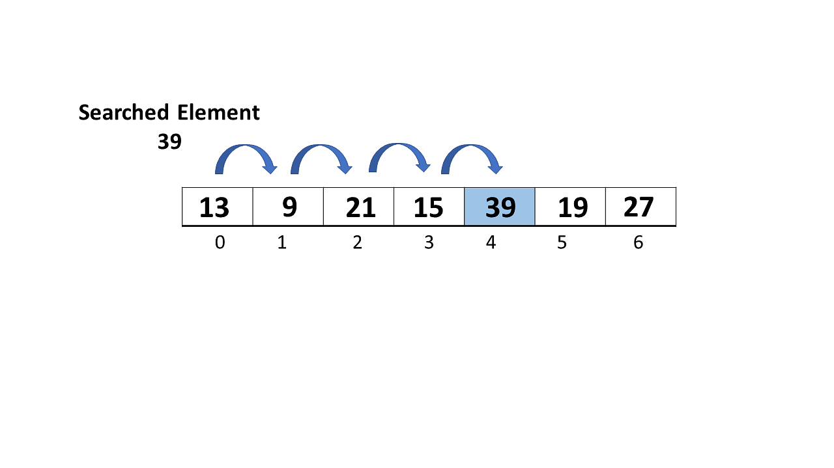
What Is a Linear Search Algorithm?
Linear search, often known as sequential search, is the most basic search technique.
In this type of search, you go through the entire list and try to fetch a match for a single element.
If you find a match, then the address of the matching target element is returned. On the other hand, if the element is not found, then it returns a NULL value.

Slide 35
Step-by-step approach employed to perform Linear Search:
Step 1: First, read the search element (Target element) in the array.
Step 2: In the second step compare the search element with the first element in the array.
Step 3: If both are matched, display "Target element is found" and terminate the Linear Search function.
Step 4: If both are not matched, compare the search element with the next element in the array.
Step 5: In this step, repeat steps 3 and 4 until the search (Target) element is compared with the last element of the array.
Step 6 : If the last element in the list does not match, the Linear Search Function will be terminated, and the message "Element is not found" will be displayed.

Slide 36
Algorithm of the Linear Search Algorithm:
Linear Search ( Array Arr, Value a ) // Arr is the name of the array, and a is the searched element.
Step 1: Set i to 0 // i is the index of an array which starts from 0
Step 2: if i > n then go to step 7 // n is the number of elements in array
Step 3: if Arr[i] = a then go to step 6
Step 4: Set i to i + 1
Step 5: Goto step 2
Step 6: Print element a found at index i and go to step 8
Step 7: Print element not found
Step 8: Exit

Slide 37
Sample Code:
#include <stdio.h>
int linear(int a[], int n, int x)
{
for (int i = 0; i < n; i++)
if (a[i] == x)
return i;
return -1;
}
int main(void)
{
int a[] = { 2, 3, 4, 10, 40 };
int x = 10;

Slide 38
int n = sizeof(a) / sizeof(a[0]);
// Function call
int result = linear(a, n, x);
if(result == -1)
{
printf("Element is not present in array");
}
else
{
printf("Element found at index: %d", result);
}
return 0;
}

Slide 39

Output:

Slide 40
Application of Linear Search Algorithm
The linear search algorithm has the following applications:
Linear search can be applied to both single-dimensional and multi-dimensional arrays.
Linear search is easy to implement and effective when the array contains only a few elements.
Linear Search is also efficient when the search is performed to fetch a single search in an unordered-List.

Slide 41
Binary Search:
Binary searches are efficient algorithms based on the concept of “divide and conquer” that improves the search by recursively dividing the array in half until you either find the element or the list gets narrowed down to one piece that doesn’t match the needed element.
Binary searches work under the principle of using the sorted information in the array to reduce the time complexity to zero.

Slide 42
Binary search approach’s basic steps:
Begin with an interval that covers the entire array
If the search key value is less than the middle-interval item, narrow the interval to that lower half. Otherwise, narrow the interval to the upper half.
Keep checking the chosen interval until either the value is found or the interval’s empty
When to Use Binary Search:
Code testing, exams, technical recruiting interviews, code challenges, library tasks, estimate maximum and minimum sizes, etc.

Slide 43
Implementation of a Binary Search:
There are two forms of binary search implementation:
Iterative and Recursive Methods.
The most significant difference between the two methods is the Recursive Method has an O(logN) space complexity, while the Iterative Method uses O (1). So, although the recursive version is easier to implement, the iterative approach is more efficient.
Iterative algorithms repeat a specific statement set a given number of times. The algorithm uses looping statements (e.g., loop, while loop, do-while loop) to repeat the same steps several times.
On the other hand, recursive algorithms rely on a function that calls itself repeatedly until it reaches the base condition (also called the stopping condition).

Slide 44
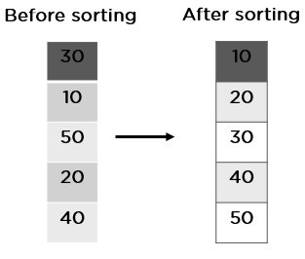
Sorting in an array:
Sorting in an array is the process in which the array elements are arranged in a user-defined order whether ascending or descending.

Slide 45
Example program:
#include <stdio.h>
void main()
{
int temp, size, array[100];
printf("Enter the size \n");
scanf("%d", &size);
printf("Enter the numbers \n");
for (int i = 0; i < size; ++i)
scanf("%d", &array[i]);
for (int i = 0; i < size; ++i)
{
for (int j = i + 1; j < size; ++j)

Slide 46
{
if (array[i] > array[j])
{
temp = array[i];
array[i] = array[j];
array[j] = temp;
} }
}
printf("sorted array:\n");
for (int i = 0; i < size; ++i)
printf("%d\n", array[i]);
}

Slide 47
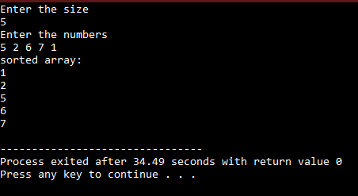
Output:

Slide 48
Advantages of Arrays in Data Structures:
Arrays store multiple elements of the same type with the same name.
You can randomly access elements in the array using an index number.
Array memory is predefined, so there is no extra memory loss.
Arrays avoid memory overflow.
2D arrays can efficiently represent the tabular data.
Disadvantages of Arrays in Data Structures:
The number of elements in an array should be predefined
An array is static. It cannot alter its size after declaration.
Insertion and deletion operation in an array is quite tricky as the array stores elements in continuous form.
Allocating excess memory than required may lead to memory wastage.

